Slide 1
Introduction to GANs
Gokula Krishnan Santhanam
(ETH Zurich)

Slide 2
About Me
Masters student @ ETH Zurich
Google Research Intern
Work on
GANs
Adversarial Attacks on CNNs
Hyperbolic DL
space.ml
Twitter: @gokstudio

Slide 3
Outline
Introduction to Generative Modelling
Introduction to GANs
Known Issues
Popular GAN Architectures
DCGAN
f-GAN
Pix2Pix / Cycle GAN
Recent Developments (6 months to 1 year)
Current Open Problems (under review)
Q&A

Slide 4
Generative Models

Slide 5
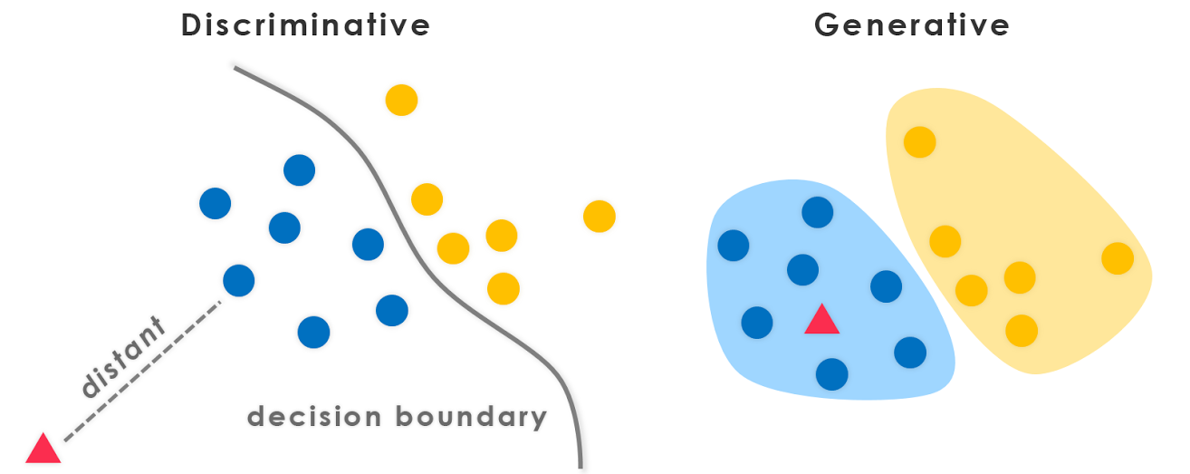
Generative vs Discriminative Models

Slide 6
Why do we need generative models?
Can do interesting things
Image denoising, image inpainting ...
Fewer labelled data to train
Less cost and time
Data generated from underlying distribution
find hidden parameters of that distribution
Notes:
https://stackoverflow.com/questions/879432/what-is-the-difference-between-a-generative-and-discriminative-algorithm

Slide 7
Common Generative Models
Gaussian mixture models
Hidden Markov model
Naive Bayes
Latent Dirichlet Allocation
Variational Autoencoders (VAE)
Generative Adversarial Networks
...

Slide 8
Difficulties
Can you look at a painting and recognize it as being the Mona Lisa? You probably can. That's discriminative modeling. Can you paint the Mona Lisa yourself? You probably can't. That's generative modeling. -- Ian Goodfellow
Difficult to design flexible models that can capture arbitrary data distributions
Notes:
TODO: write the issues about learning a generative model
http://dustintran.com/blog/how-much-compute-do-we-need-to-train-generative-models

Slide 9
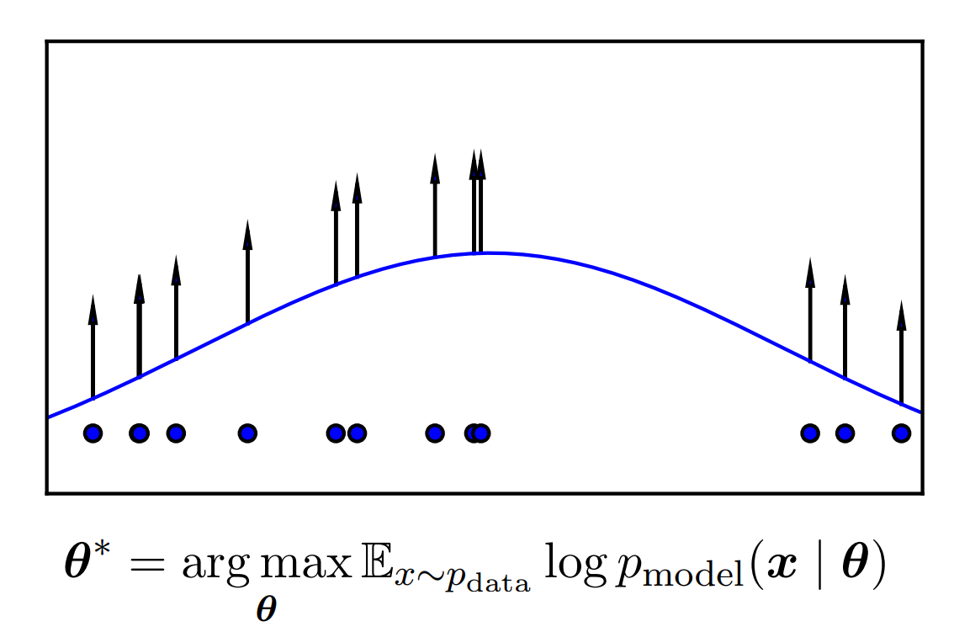
How to learn Generative models?

Slide 10
GANs

Slide 11
GANs
Generative Adversarial Networks
Involves two networks
Generator
Discriminator
Min-Max game between the two

Slide 12
Adversarial?
Two networks
Try to best each other
Zero-Sum Game

Slide 13
Nash Equilibrium in GANs
Generator has learnt the data distribution
Discriminator is confused
Can’t discriminate between generated data pts and data distribution
Discriminator can effectively cover the data distribution
Caveat: Idealistic Scenario

Slide 14
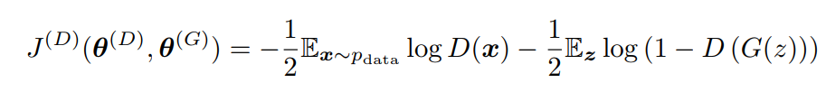
The Hello World equation of GANs
Generator minimizes the log-probability of the discriminator being correct
Notes:
L(G) and L(D) here

Slide 15
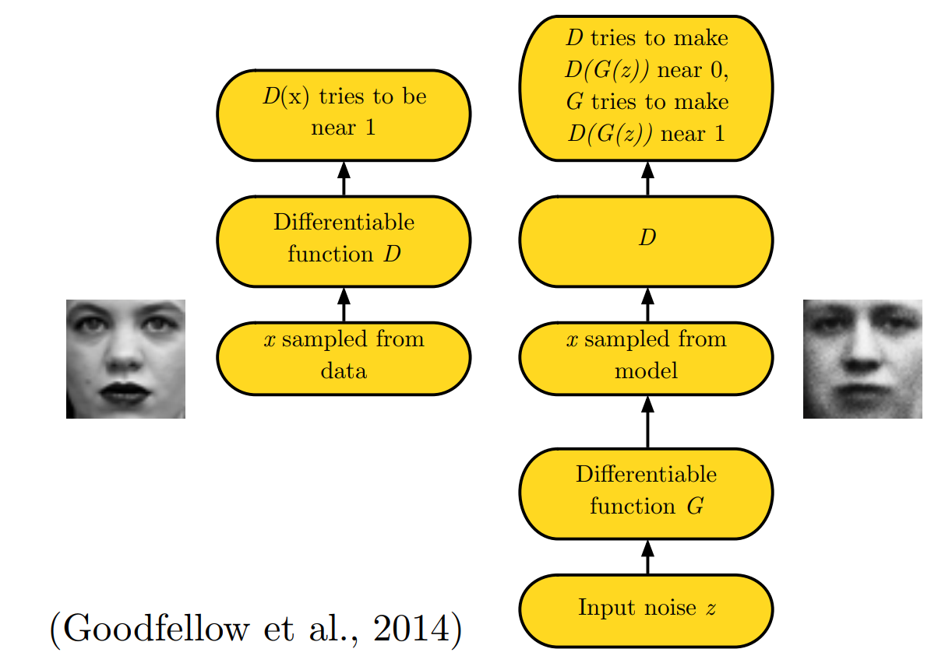
General GAN Architecture

Slide 16
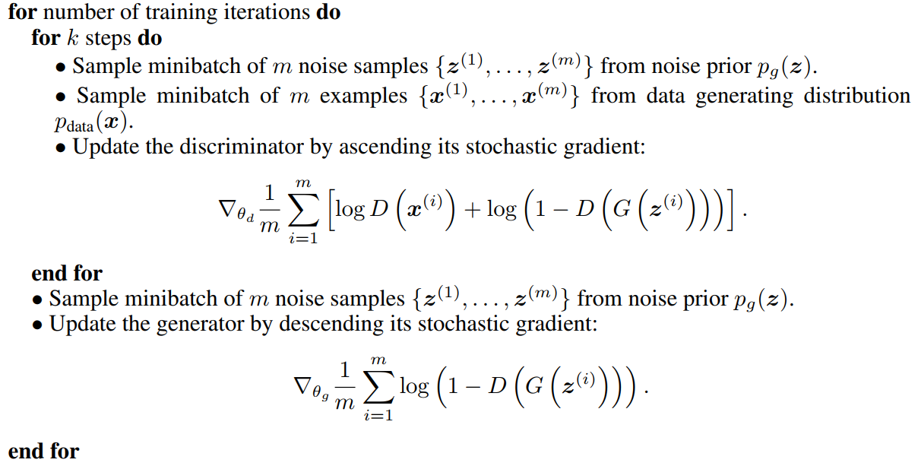
The Training Process

Slide 17
Gradients
Updates to G
Updates to D

Slide 18
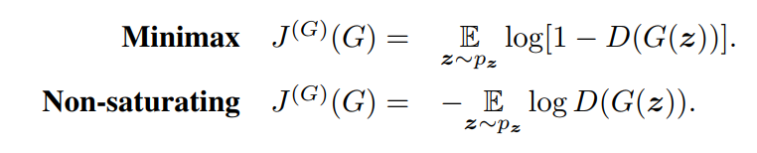
How to update generator?

Slide 19
Quick Example in TensorFlow
#Inputs
images = tf.placeholder(shape = [None, 32, 32, 3], dtype = tf.float32)
noise = tf.placeholder(shape = [None, noise_dime], dtype = tf.float32)
gen_op = generator(noise)
real_logits = discriminator(images)
fake_logits = discriminator(gen_op)
d_loss_real = tf.softmax_cross_entropy_with_logits(logits = real_logits, labels = tf.ones_like(real_logits)
d_loss_fake = tf.softmax_cross_entropy_with_logits(logits = fake_logits, labels = tf.zeroes_like(real_logits)
D_loss = d_loss_real + d_loss_fake
G_loss = tf.softmax_cross_entropy_with_logits(logits = fake_logits, labels = tf.ones_like(fake_logits))

Slide 20
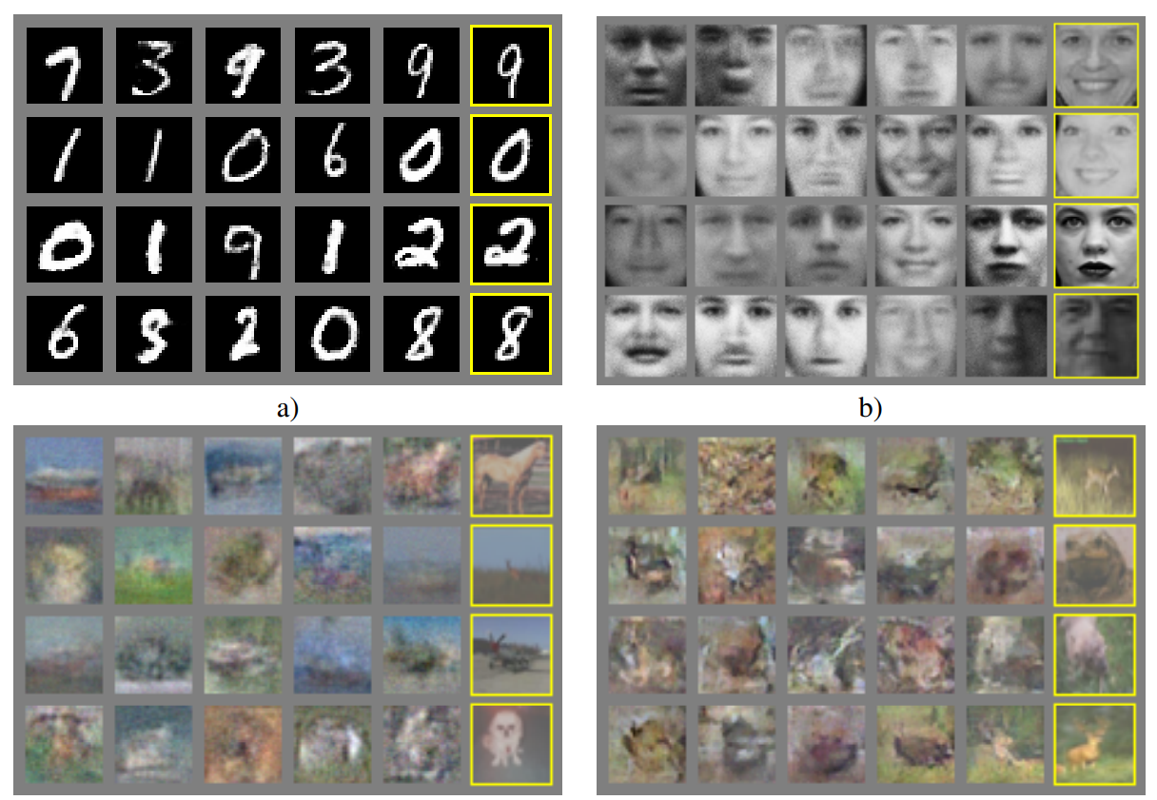
Initial Results
Notes:
GAN (Goodfellow) architecture

Slide 21
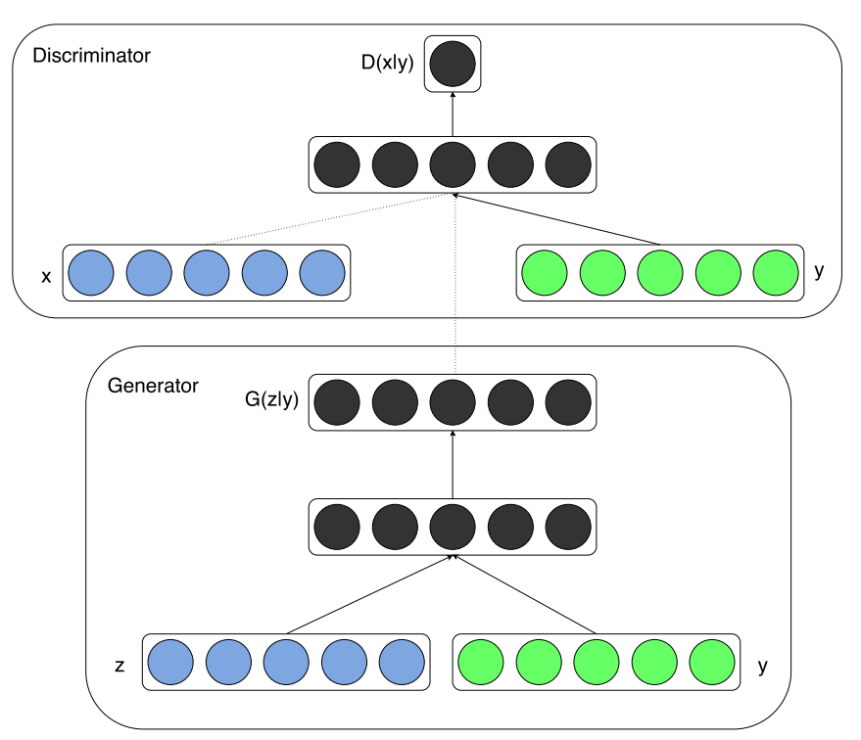
Conditional GANs
Notes:
Pics from cGAN paper

Slide 22
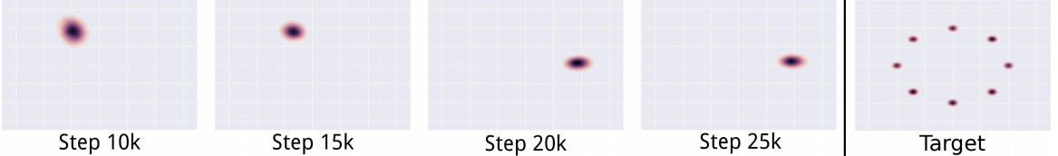
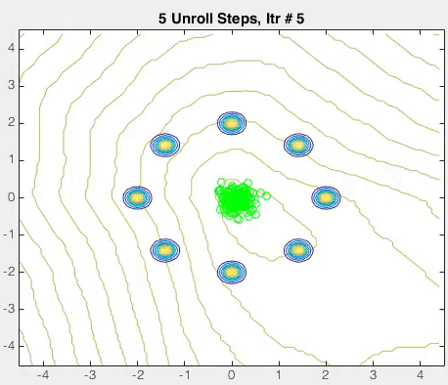
Are we done?
Notoriously hard to train
Mode collapse
Non-convergence
Catastrophic degradation over prolonged training
No objective performance metric

Slide 23
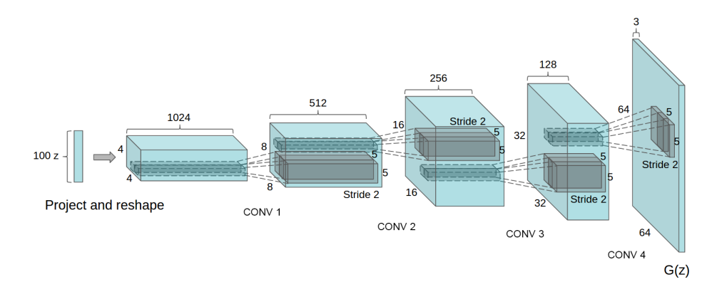
DCGANs

Slide 24
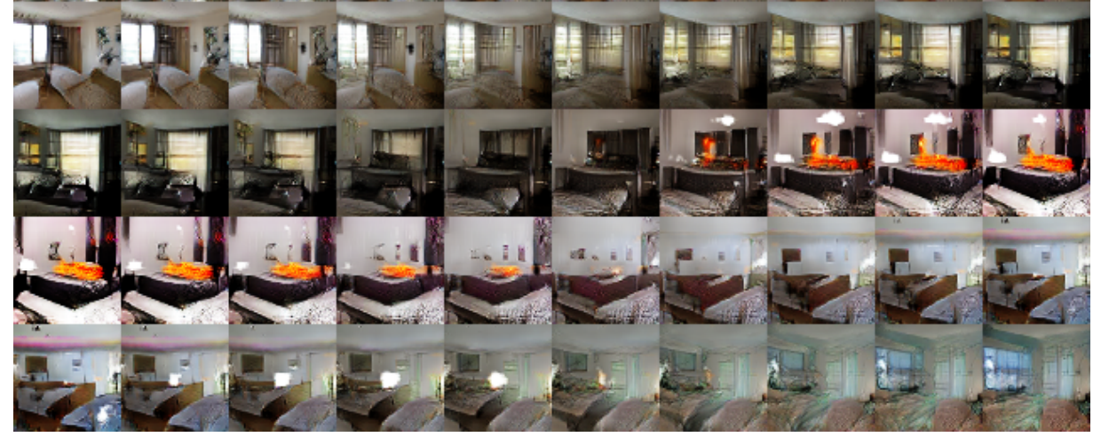
Walking through the latent space

Slide 25
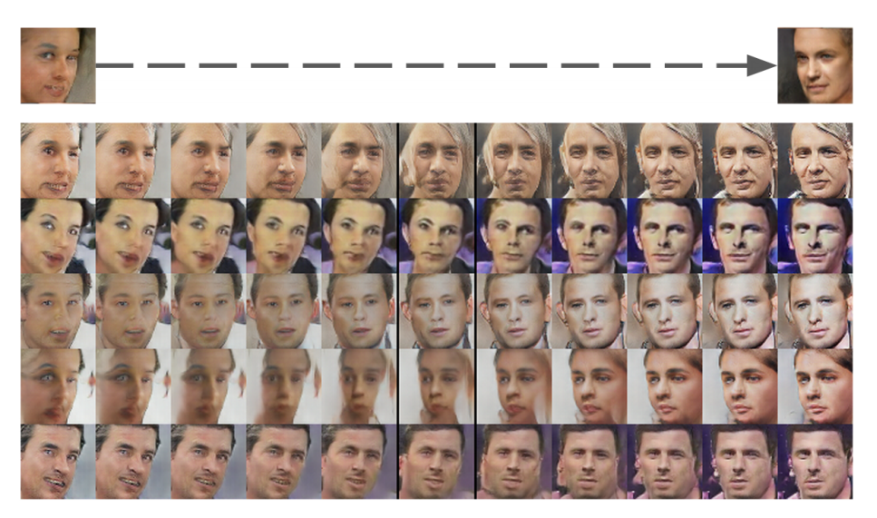
Face Pose modeled linearly in Latent Space

Slide 26
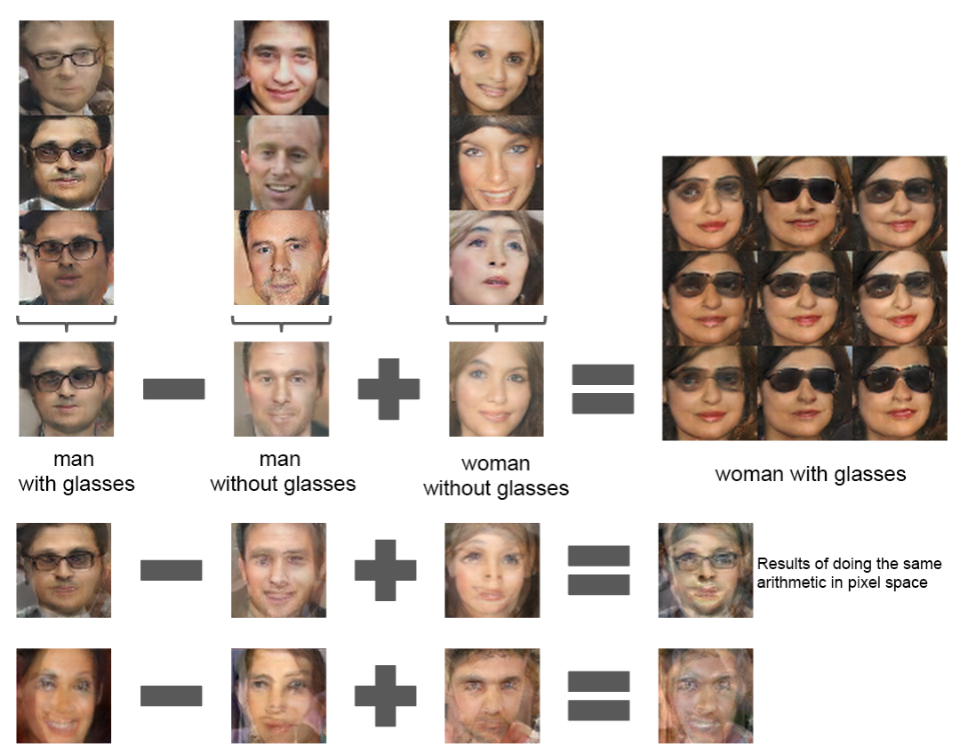
Vector Arithmetic on the Latent Space
Notes:
Averaging Z vector for three examplars showed consistent and stable generations that semantically obeyed the arithmetic

Slide 27
The Divergence View
Training reduces divergence between data distribution and Generator distribution
Could be any divergence
Jensen Shannon divergence for WGAN
F-divergence for F-GANs
Divergence minimized at convergence

Slide 28
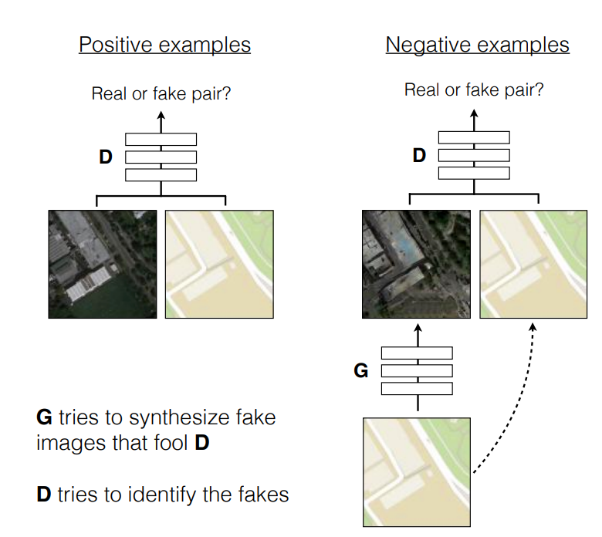
Learning Image Transformations: Pix2Pix

Slide 29

Cycle-GAN
Notes:
Cycle-inconsistency loss: From F to G and back, also add the difference between F and G-1(G(F))

Slide 30
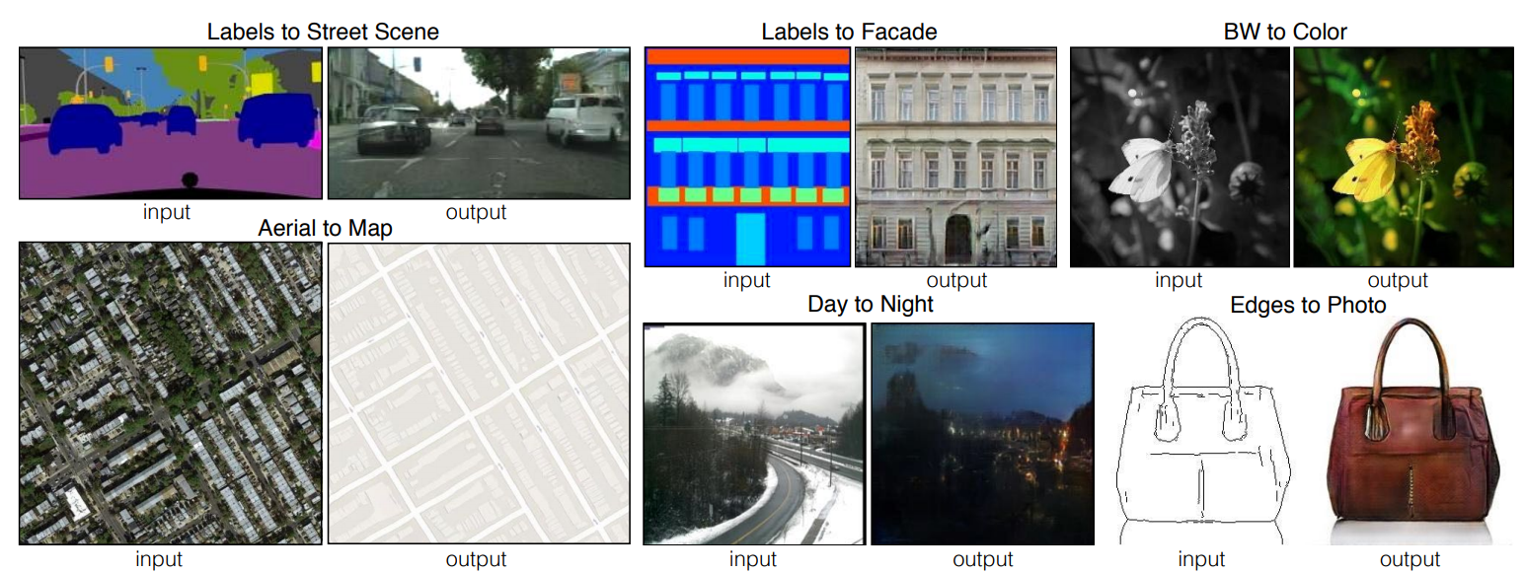
Applications

Slide 31
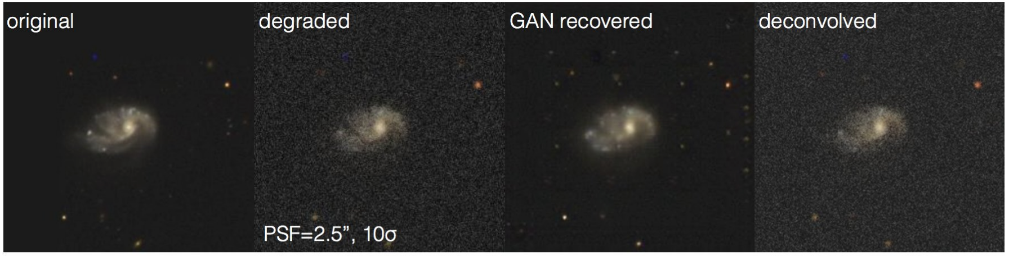
GANs in Astronomy
Generative Adversarial Networks recover features in astrophysical images of galaxies beyond the deconvolution limit (https://arxiv.org/abs/1702.00403)
(Covered by WIRED, The Atlantic, Science, The Register, phys.org)

Slide 32
Recent Developments

Slide 33
Broad Themes
Evaluating GANs
Tackling failure modes
Altering optimization process
Application of GANs

Slide 34
Quantitative Metrics (Inception Score)
“My GAN’s better than yours and I have numbers to prove it”
Apply Inception model to generated images
Get conditional label distribution p(y|x)
Images with meaningful objects have conditional label distribution p(y|x) with low entropy
Higher is better

Slide 35
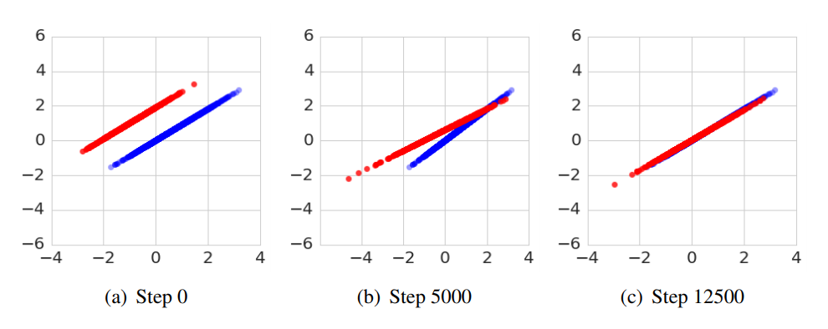
Do we need to reduce divergences?
Many Paths to Equilibrium (https://arxiv.org/abs/1710.08446)
Show that divergence minimization is not the complete picture
GANs converge even when divergence reduction says it shouldn’t

Slide 36
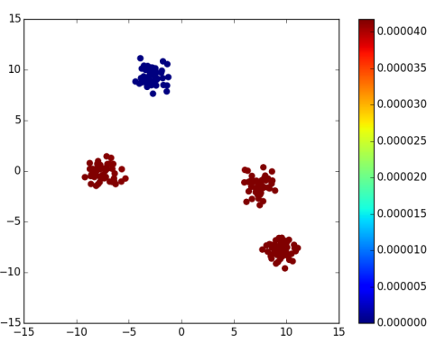
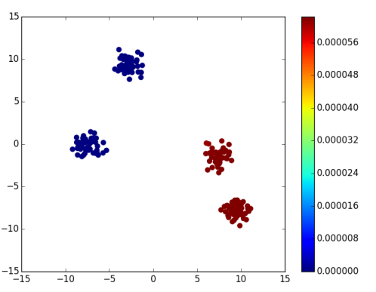
Progress in handling Mode-Collapse
Ada-GAN (https://arxiv.org/abs/1701.02386)
Like AdaBoost, ensemble of weak generators + reweighting of samples

Slide 37
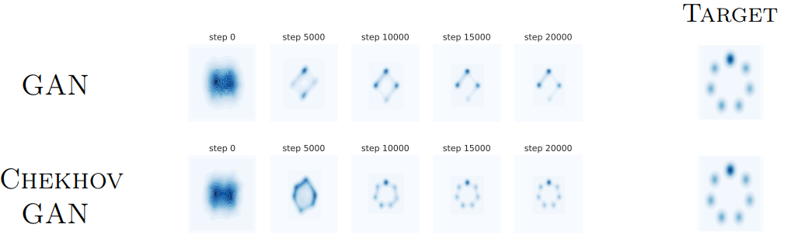
Provable Convergence
Cherkov GAN
GAN Training: find a mixed strategy in a zero-sum game.
Method provably converges to an equilibrium for semi-shallow GAN architectures
Notes:
architectures where the discriminator is a one layer network and the generator is arbitrary.

Slide 38
GANs for Text
Not been applied to NLP
GANs are only defined for real-valued data
All NLP based on discrete values (words, characters, or bytes)
no way to make a slight change.
No one really knows how to apply GANs to NLP (yet)
Could use the REINFORCE algorithm

Slide 39
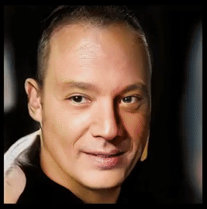
Progressive GANs
High-resolution image generation

Slide 40
Questions?

Slide 41
Thanks!

Slide 42
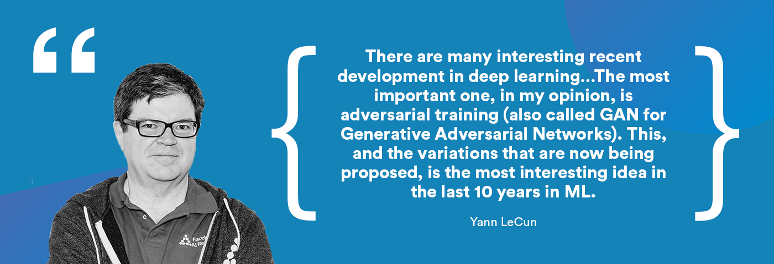
It’s Hot!

Slide 43
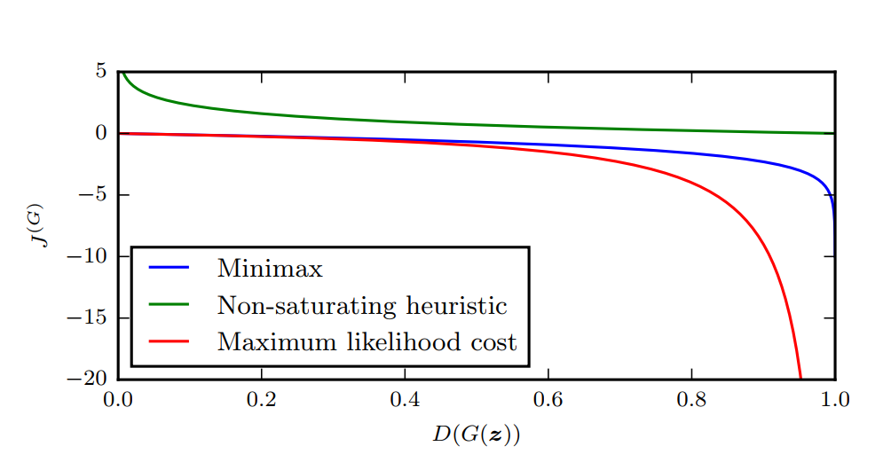

Slide 44
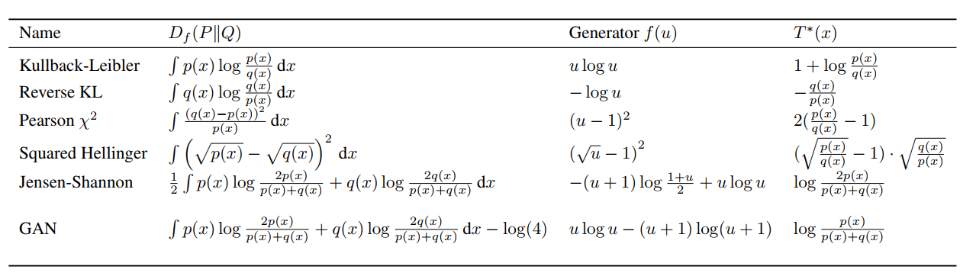
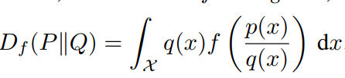
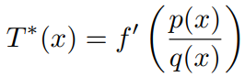
f-GANs
Model GAN training as divergence minimization
(tight variational lower-bound)

Slide 45
What’s next?
Applications
Healthcare
Drug discovery
Malware detection
Program synthesis
Core research directions
Convergence bounds
Explanation for failure modes
Divergence view is incomplete, what’s missing?
GANs for discrete data

Slide 46
How to get started?
The original GAN paper
GAN tutorial by Ian Goodfellow
Soumith Chintala’s GAN Hacks (https://github.com/soumith/ganhacks)
DCGAN implementation (https://github.com/gokul-uf/TF-DCGAN)
Toy Examples - Mixture of Gaussians
WGAN / f-GAN / WGAN-GP
ICLR / NIPS / ICML / CVPR / ICCV

Slide 47
The Criminal Police Game
Counterfeiters tries to counterfeit currency notes
Police tries to catch them
Police crack down on counterfeiting
Counterfeiters improves the quality of counterfeits
Police improve their detection techniques
...

Slide 48
Game Theory 101

Slide 49
Definition
Study of mathematical models of conflict and cooperation between intelligent rational decision-makers
Game: Situations in which at least one player can only act to maximize his utility through anticipating the responses to his actions by one or more other players
Players: Individual rational decision-makers
Could be
Individuals (Resource Sharing)
Corporations (Free Markets)
Nation States (Diplomacy)

Slide 50
Nash Equilibrium
Solution of a non-cooperative game involving two or more players in which each player is assumed to know the equilibrium strategies of the other players, and no player has anything to gain by changing only his own strategy.
Mutual assured destruction
A full-scale use of nuclear weapons by two or more opposing sides would cause the complete annihilation of both the attacker and the defender

Slide 51
Back to GANs

Slide 52
Applications
In Physics
Learning Particle Physics by Example
Simulating 3D High Energy Particle Showers
In Chemistry
Generate compounds with certain attributes
https://chemrxiv.org/articles/ORGANIC_1_pdf/5309668
In Biology
Cleaning Cryo-EM images
DeepCancer: Detecting Cancer through Gene Expressions via Deep Generative Learning
Medical Image Synthesis
In medicine
Generating “fake” patient records

